Slide 1


Slide 2
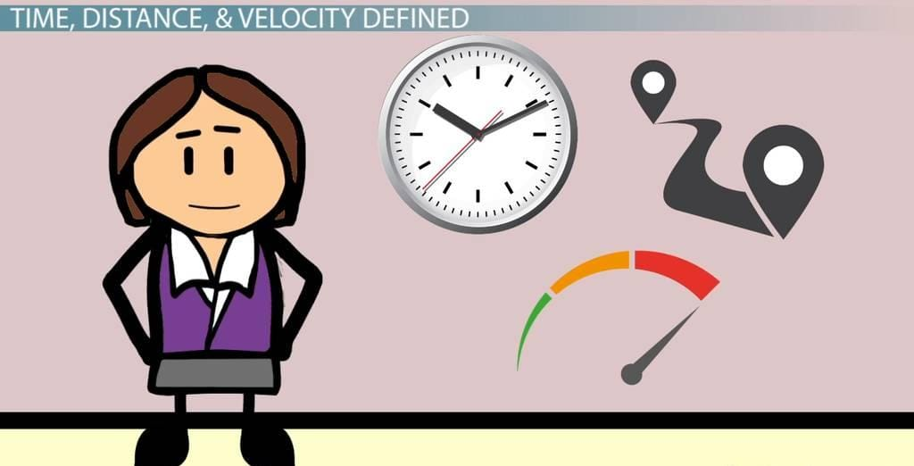

Slide 3
A train 100 m long is running at the speed of 30 km/hr . find the time taken by it to pass a man standing near the railway line.
(a) 8 sec (b) 10 sec
(c) 12 sec (d) 16 sec

Slide 4
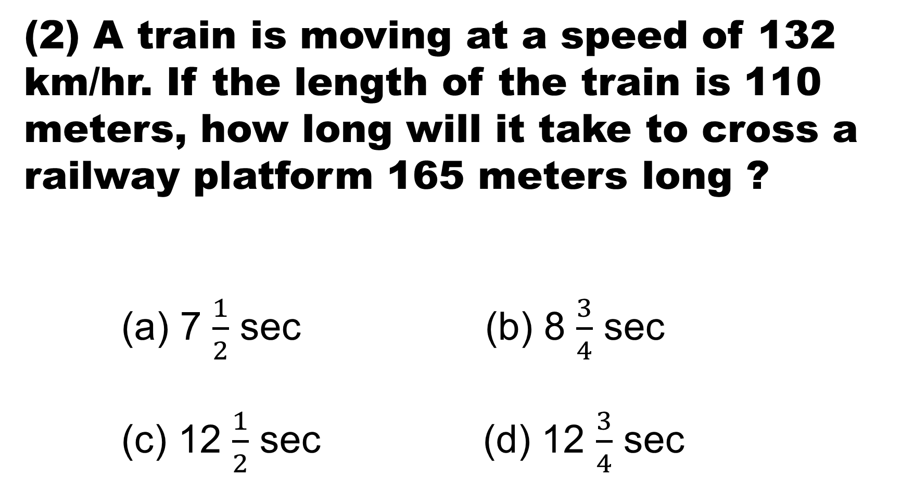
(2) A train is moving at a speed of 132 km/hr. If the length of the train is 110 meters, how long will it take to cross a railway platform 165 meters long ?
(a) 7 $\frac{1}{2}$ sec (b) 8 $\frac{3}{4}$ sec
(c) 12 $\frac{1}{2}$ sec (d) 12 $\frac{3}{4}$ sec

Slide 5
(3) A man is standing on a railway bridge which is 180 m long. He finds that a train crosses the bridge in 20 seconds but himself in 8 seconds. Find the length of the train and its speed..
(a) 52 kmpl (b) 54 kmpl
(c) 60 kmpl (d) 62 kmpl

Slide 6
(4) A train 150 m long is running with a speed of 68 kmph. In what time will it pass a man who is running at 8 kmph in the same direction in which the train is going ?
(a) 9 sec (b) 12 sec
(c) 15 sec (d) 18 sec

Slide 7
A train 220 m long is running with a speed of 59 kmph. In what time will it pas a man who is running at 7 kmph in the direction opposite to that in which the train is going ?
(a) 10 sec (b) 12 sec
(c) 24 sec (d) 26 sec

Slide 8
Two trains 137 meters and 163 meters in
length are running towards each other on
parallel lines, one at the rate of 42 kmph and
another at 48 kmph. In what time will they
be clear of each other from the
moment they meet ?
(a) 12 sec (b) 20 sec
(c) 24 sec (d) 28 sec

Slide 9
Two trains 100 meters and 120 meters long are running in the same direction with speeds of 72 km/hr and 64 km/hr. In how much time will the first train cross the second ?
(a) 55 sec (b) 66 sec
(c) 33 sec (d) 44 sec

Slide 10
(8) The length of a train and that of a platform are equal. If with a speed of 90 km/hr , the train crosses the platform in one minute, then the length of the train (in meters) in:
(a) 500 (b) 600
(c) 750 (d) 900

Slide 11
(9)Two trains are running in opposite directions with the same speed. If the length of each train is 120 meters and they cross each other in 12 seconds, then the speed of each train (in km/hr) is:
(a) 10 (b) 18
(c) 36 (d) 72

Slide 12
(10) Two trains of equal lengths take 10 seconds and 15 seconds respectively to cross a telegraph post. If the length of each train be 120 meters, in what time (in seconds) will they cross each other travelling in opposite direction ?
(a) 10 (b) 12
(c) 15 (d) 20

Slide 13
(11) Only a single railway track is available for trains in Konkan area. A train travelling with uniform speed of 50 km per hr. leaves station 'Ax' at 7.40 am to reach the station 'By', which is situated at a distance of 100 km from 'Ax' At 8.10 am a train travelling with uniform speed of 40km per hr. leaves station By' to reach the station 'Ax'. The Traffic Controller noticed this situation at 8.40 am. Select the time duration that the controller has mathematically, for making decision, for avoiding collision between these two trains.
(a) 20 minutes (b) 19 minutes
(c) 21 minutes (d) 15 minutes.

Slide 14
(12) Two scooter riders moving in opposite directions start at the same time from opposite ends of a 100-unit-long road. Each rider moves at a speed of 40 units per hour. At the moment they start, a fly leaves one of the riders and flies to land on the other. If the fly travels at 60 units an hour, select the option that indicates distance: in units the fly needs to travel.
(a) 160 (b) 140
(c) 300 (d) 200

Slide 15
(13) Vini travels by monorail to work. She has to use escalator to reach the platform. It takes her 21.0 seconds to reach the top of the escalator if she runs 8 steps. If she runs 13 steps it takes only 13.5 seconds. Select the number of seconds that she would require to reach the top of escalator if she decides not to run any step.
(a) 22 (b) 33
(c) 27 (d) 22.2

Slide 16
(14) Asifa and Ajita are in a hurry so they are climbing down the constantly moving down escalator. Asifa and Ajita take 40 and 60 steps to reach the floor respectively. While Ajita takes 3 steps, Asifa takes 1 step in the same time. Select the number that indicates the total steps each one is required to climb down if the escalator is not moving.
(a) 100 (b) 80
(c) 40 (d) 60

Slide 17
(15) Train A has a length of x meters and speed of u km/hour. Train B has a length y meters and speed of v km/hour. The two trains take t minutes to cross each other when they travel parallel in opposite directions, and 4t minutes to cross each other when they travel in the same direction. If u 50km / hour. What is the value of v ?
(a) 30km / hour (b) 70km / hour
(c)40km / hour (d) 50km / hour

Slide 18
(16) From Mumbai to Pune there are two buses. Out of these the first bus starts at 8 o'clock at 80 km per hour and on the same day the second bus starts at 9 o'clock at 100 km per hour. Then these two buses meet after how many hours and at what time?
(a)3 hours later at 11 o'clock
(b) 3 hours later at 12 o'clock
(c) 4 hours later at 12 o'clock
(d) 4 hours later at 01 o'clock

Slide 19


